Slide 1

An E-Learning Maths Website
Abdullah Tarofdear

Slide 2
PURPOSE
Pupose of Maths Squared
The main purpose of Maths Squared is to teach people how to accomplish calculations using arithmetic skills rather than people being dependant on calculators that people have grown accustomed to over the last few years.
Reduce the dependency for parents who rely on private tuition to make sure their children do not fall behind in class.
How does Maths Squared fufil this purpose
Many different methods are shown to do the same calculation so the user has a choice on what is easier for them to use.
All the content provided is free and is accessible for anyone anywhere.

Slide 3
THE PROBLEM
The British public spent £6 billion in 2012 to make sure their children is getting the support they need with many saying it is a necessity they can barely afford. [1]
Students in classrooms spend approximately 90% sitting listen passively or not focussing at all. [2]
With students now struggling to focus in lessons which are usually 1 hour long due to smartphone, this can potentially cause a catalyst for the fall in student’s grades.
A solution for all of this would be to use free alternatives such as e-learning maths websites where students can access online material
Notes:
[1] The Telegraph. (2012). Parents spend £6bn a year on private tuition. Available:
https://www.telegraph.co.uk/finance/personalfinance/9651689/Parents-spend-6bn-a- year-on-private-tuition.html.
[2] The Washington Post. (2014). Teacher spends two days as a student and is shocked at what she learns. Available: https://www.washingtonpost.com/news/answer-sheet/wp/2014/10/24/teacher-
90spends-two-days-as-a-student-and-is-shocked-at-what-she-learned/.

Slide 4
AIMS AND OBJECTIVES
Focus: APPEARANCE OF THE WEBSITE
Aim: MAKE SURE USERS WHO VISIT THE WEBSITE ARE ATTRACTED TO IT
Objective:
PROFESSINAL LOOKING PAGE
FOLLOW MODERN DESIGN TRENDS
FOLLOW THE GESTALT PRINCIPLES
Focus: EASY UNDERSTANDING CONTENT
Aim: USERS LEAVE THE WEBSITE SATISFIED WITH WHAT THEY HAVE LEARNT
Objective:
PROVIDE QUIZZES, WORKSHEETS AND VIDEOS
SOCIAL MEDIA PAGES FOR CONTACT SUPPORT
TEXT + IMAGES FOR CONTENT TO HELP VISUALISE THE PROBLEM

Slide 5
PLAN
Research
Report + Survey
Design
Implement
Test
Presentation

Slide 6
MAIN FEATURES OF THE WEBSITE
The main functions of the E-Learning website are:
Provide a variety courses from KS2 to GCSE
A full functioning login and register system
A search bar tool
Variety types of quizzes and worksheets
A profile page where username, email and password can be changed
Dashboard page where quiz results will be stored and displayed
Social media pages
Easy to use interface

Slide 7
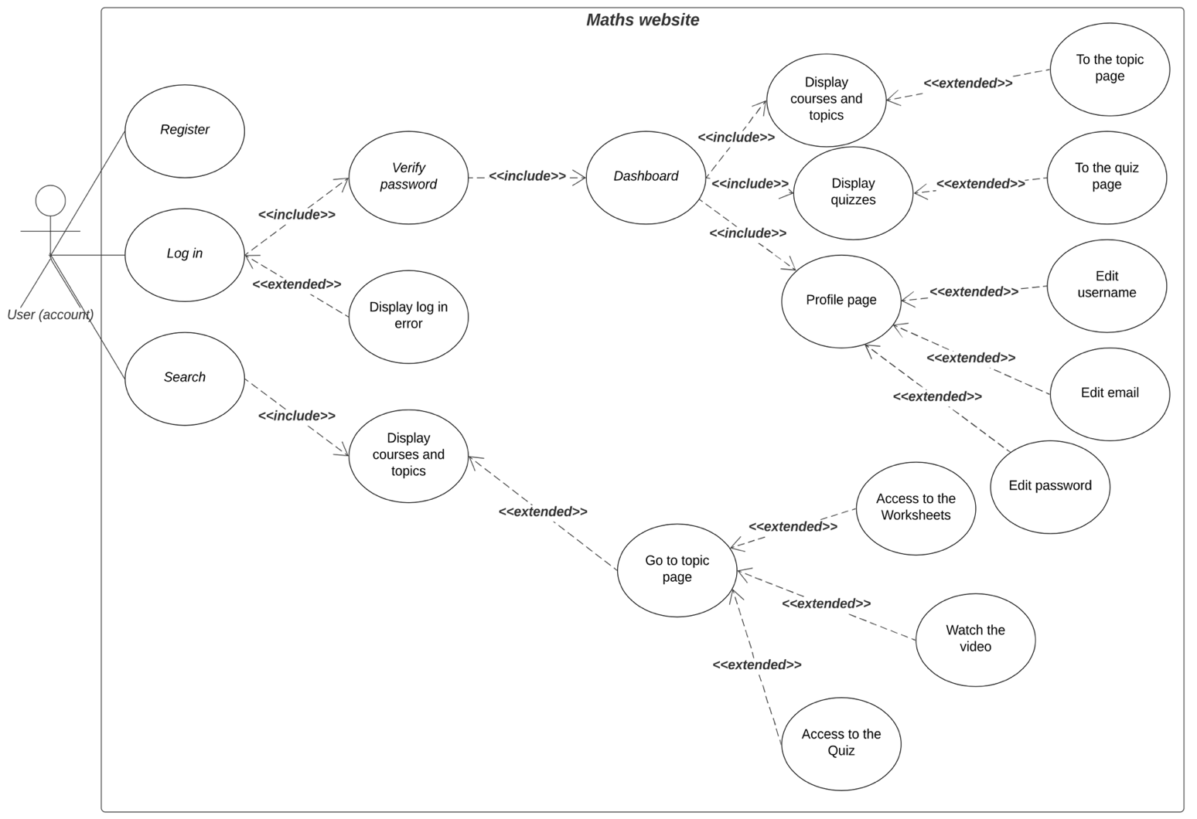
USE CASE MODELS
2 Use Case Models; 1 for users with an account and another without an account
User (account) can login and access the dashboard page where it displays the quiz results and courses/topics as well access to the profile page. Also makes use of the search bar feature
User (no account) only has access to the search bar to view the content

Slide 8
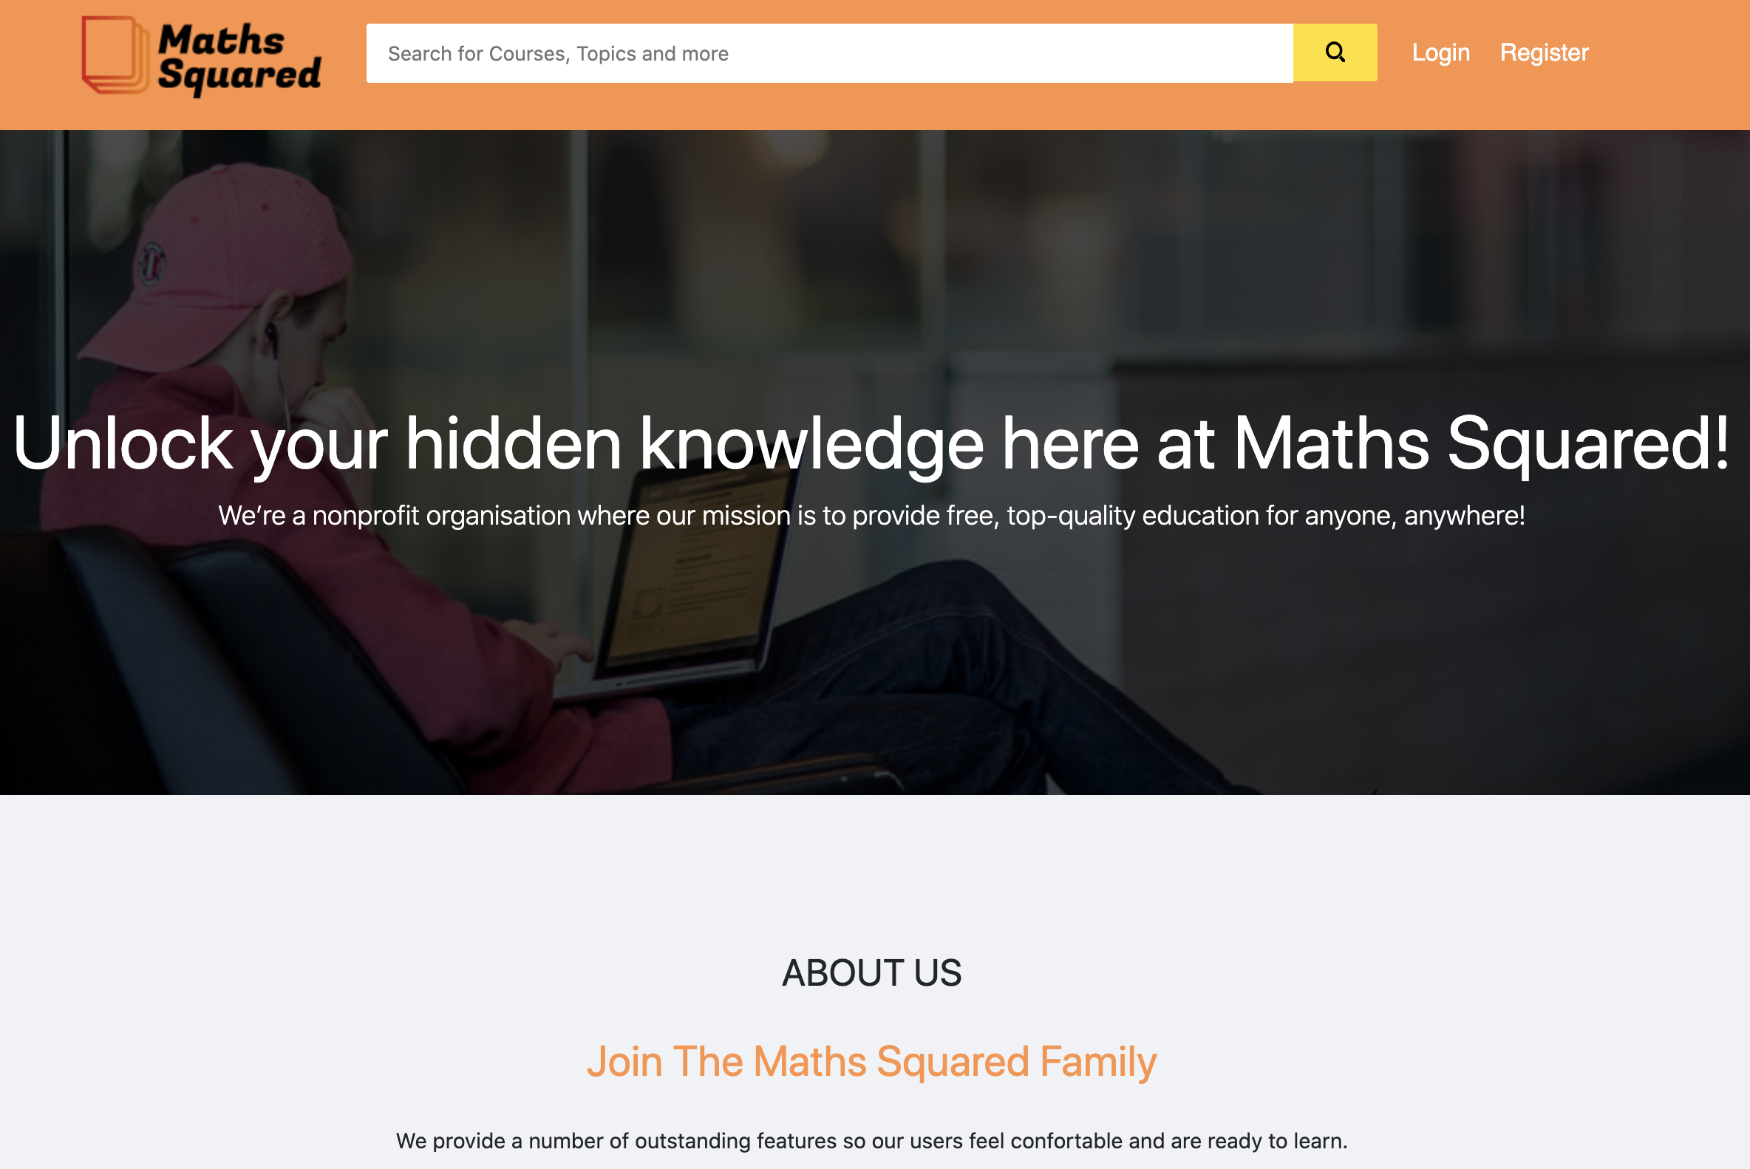
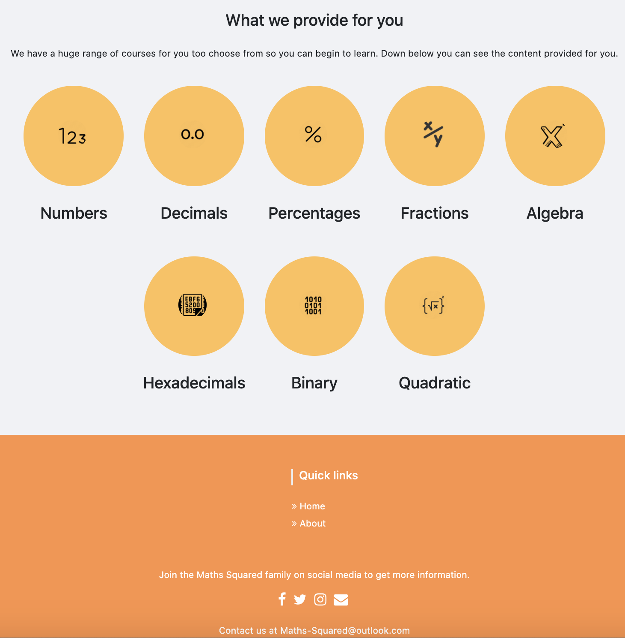
USER INTERFACE – HOME PAGE
Login or register with the website. Gain access to the dashboard page where quiz results and profile page is stored.
The logo of the brand. Also a button to go to the home page
A search bar. Users with or without an account can use it.
Big banner introducing the website. This is the same for each topic page.
A brief description of what the website is about.
A service section providing users what courses are available

Slide 9
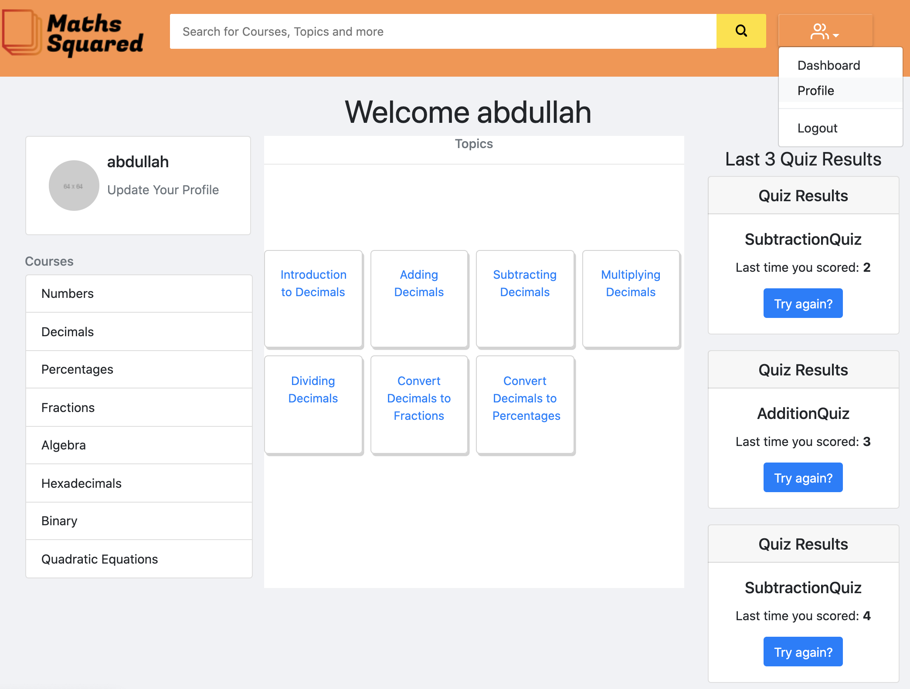
USER INTERFACE – DASHBOARD
A drop-down menu to access the dashboard, profile page or log out.
A greeting message with their username.
Users profile page. Can update their email, name or password.
Shows the users last 3 quiz results they have attempted.
All the courses available for the user
All the topics for the related course. User clicks on a course for the topics to appear in the center.

Slide 10
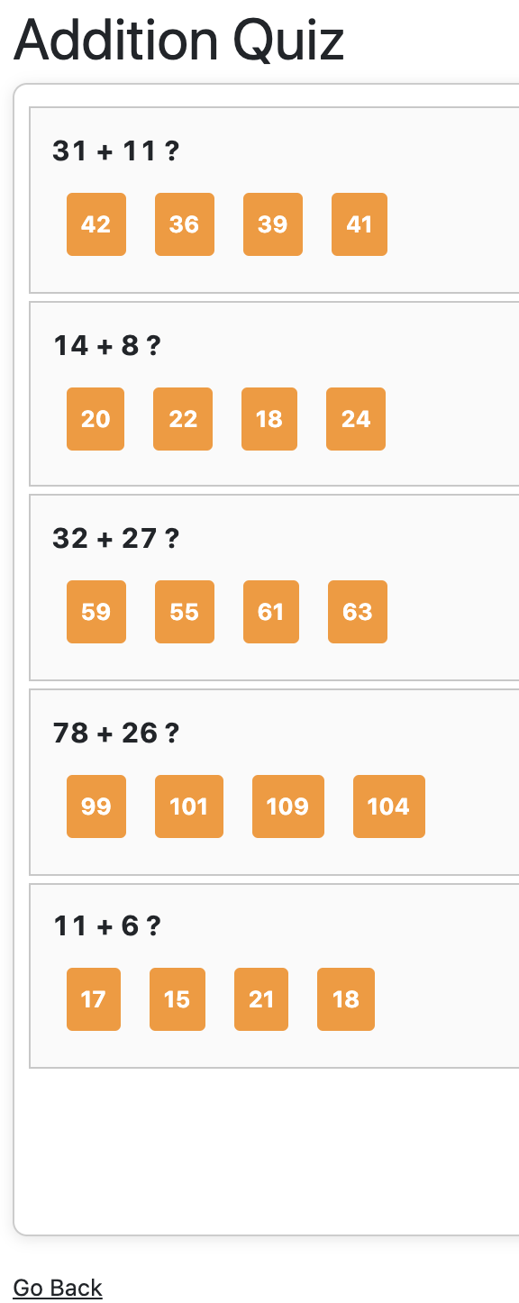
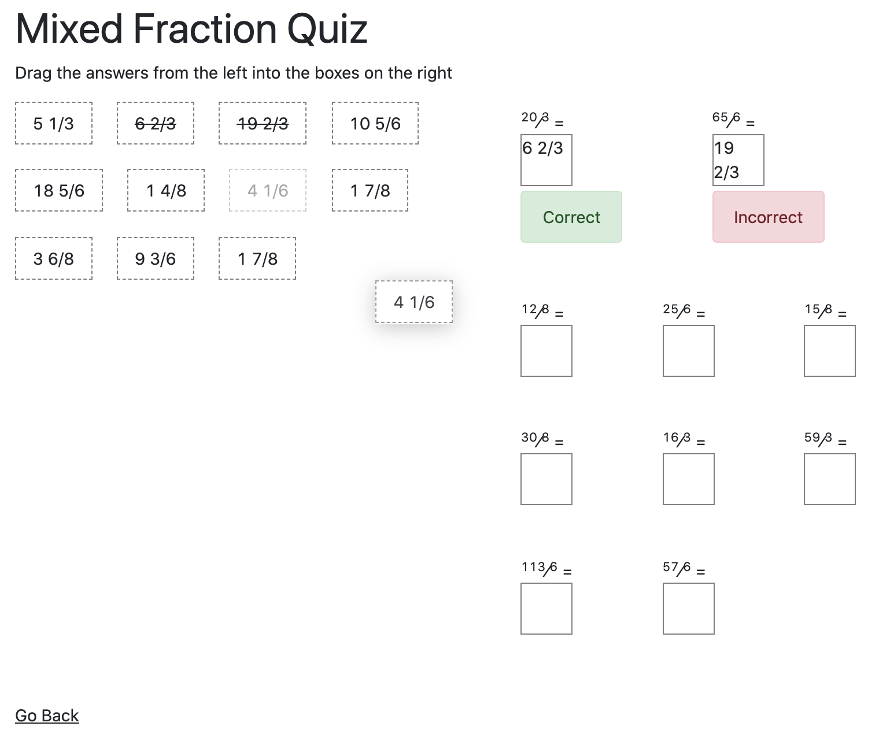
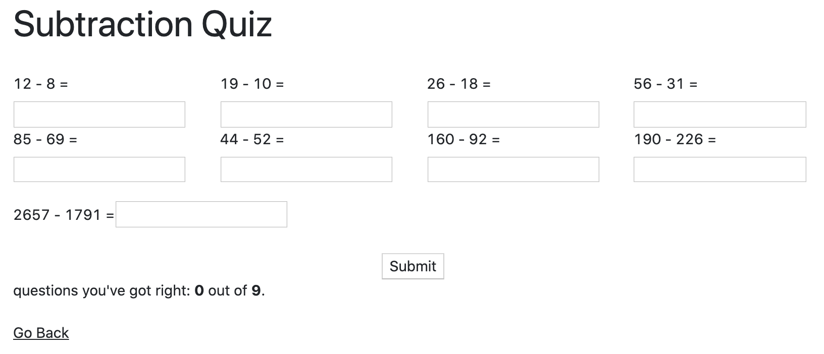
THE 3 TYPES OF QUIZZES
A text console quiz. Users enter an answer of their choice and the submit the answers. The results will be presented at the bottom of the page.
A multiple choice quiz. Users select their answer and the result will appear at the end.
A drag and drop quiz. Users drop an answer of their choice for a question and will present the user if they are correct or not.

Slide 11
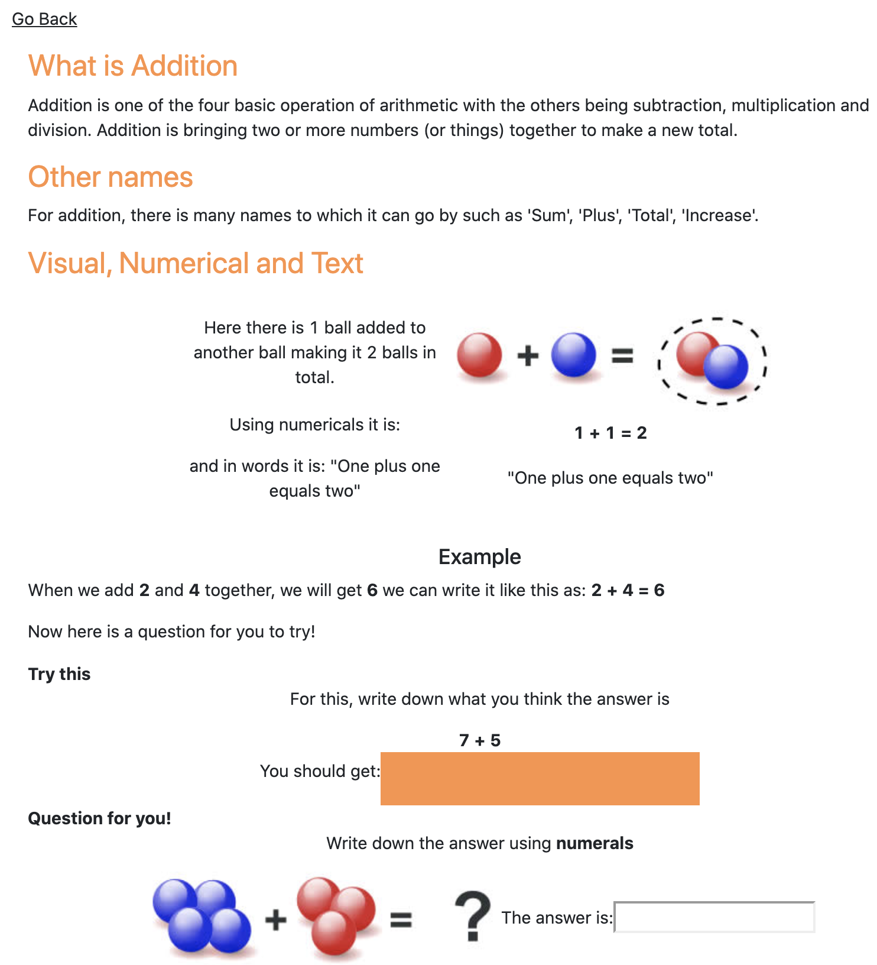
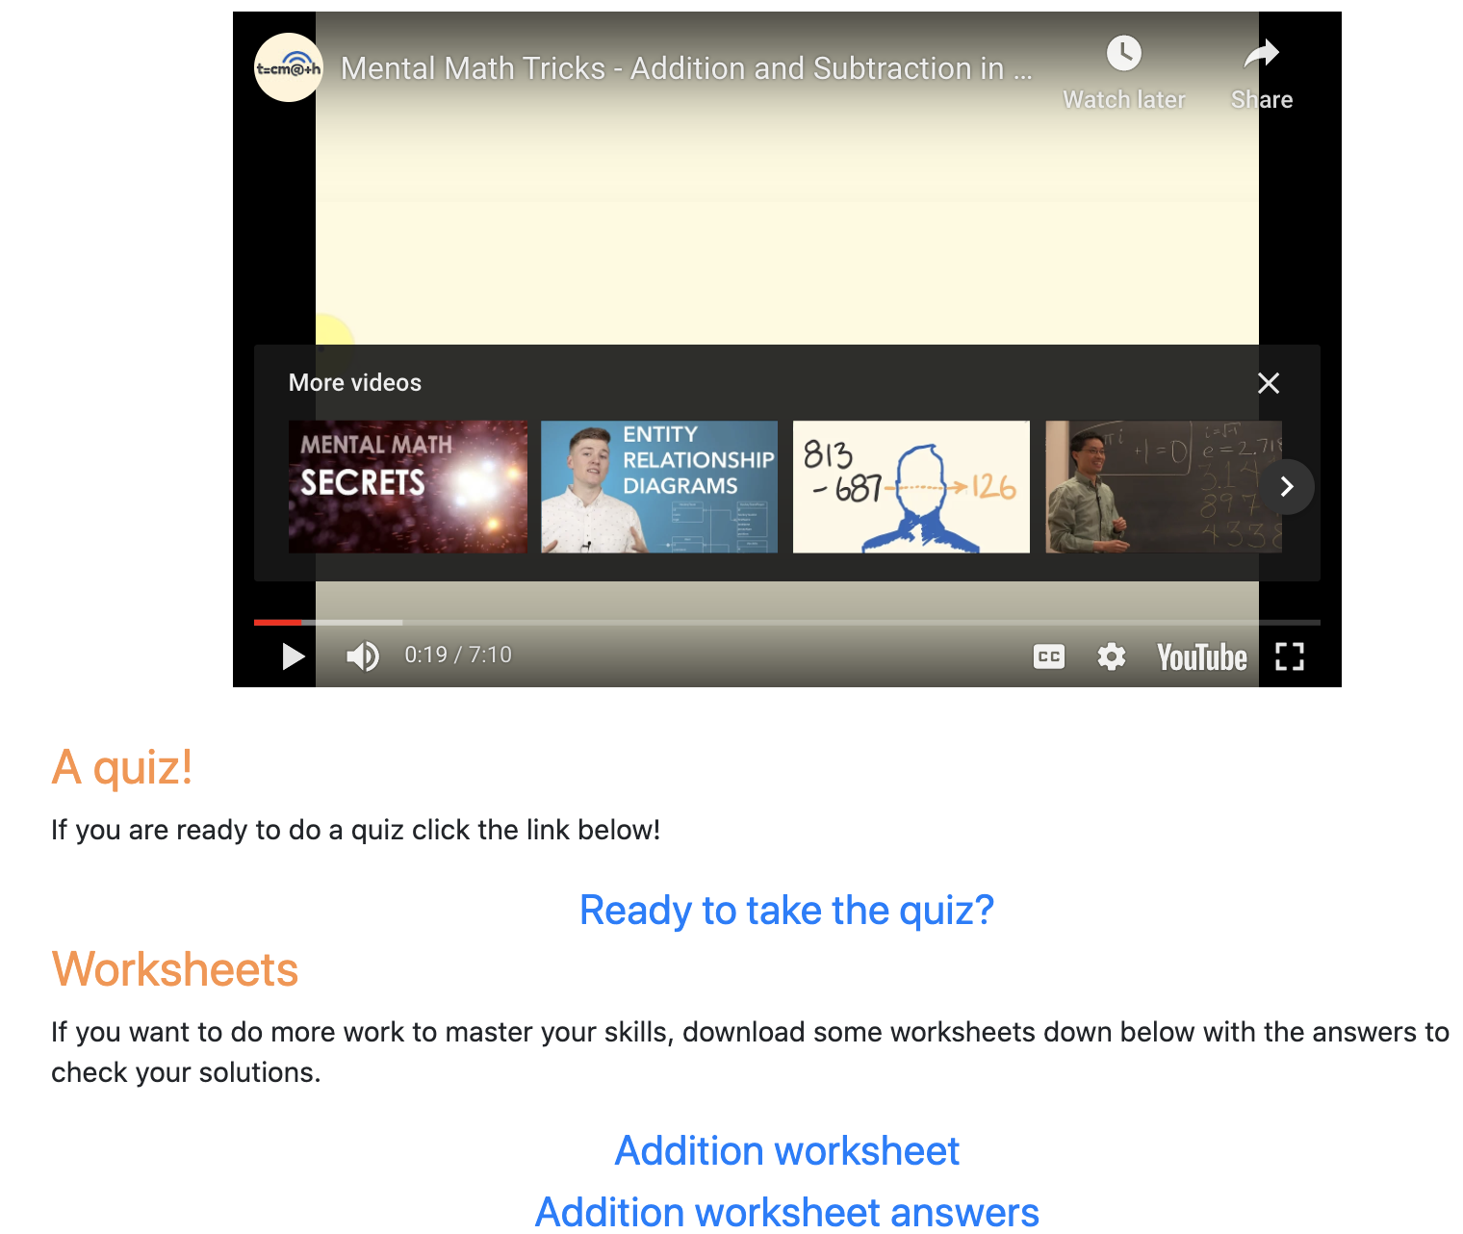
TOPICS PAGE
At the bottom of each page, a video is displayed to help further understand the content.
Images to help visualize and understand content easier
Hover box when the mouse is over it, will display the answer. Makes it more interactive
Quiz is available to test their knowledge.
Worksheet with answers are available to build confidence on
Interactive text console where the user enters a number and will say if it is correct or incorrect

Slide 12
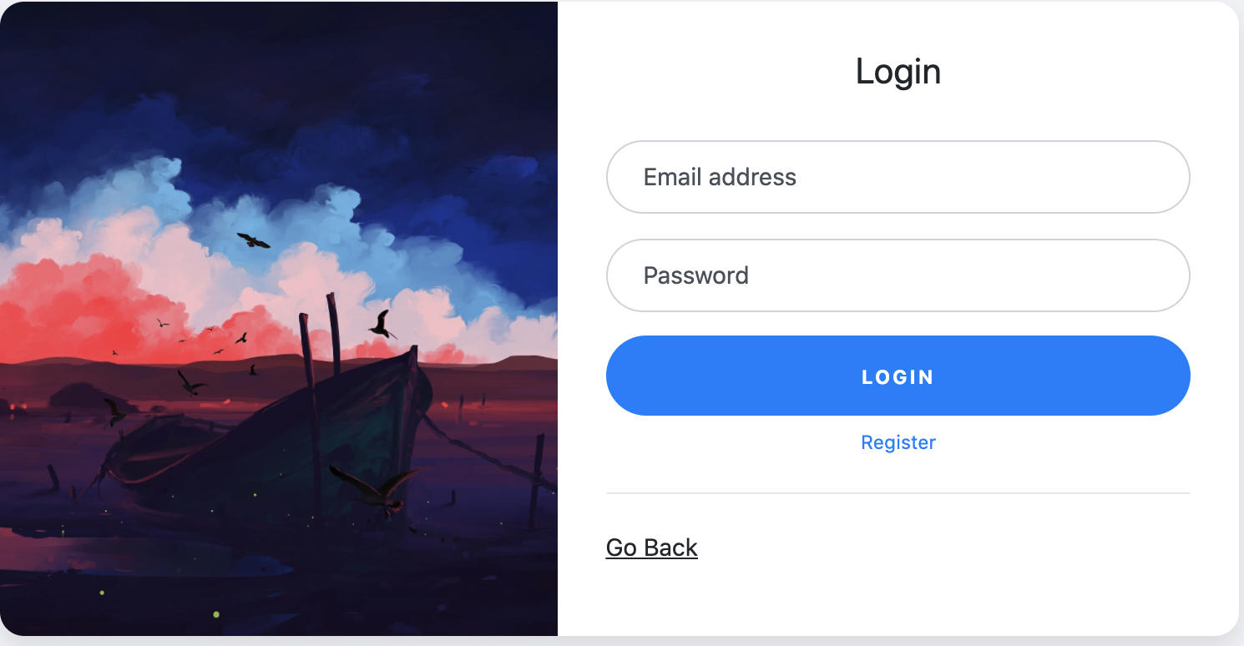
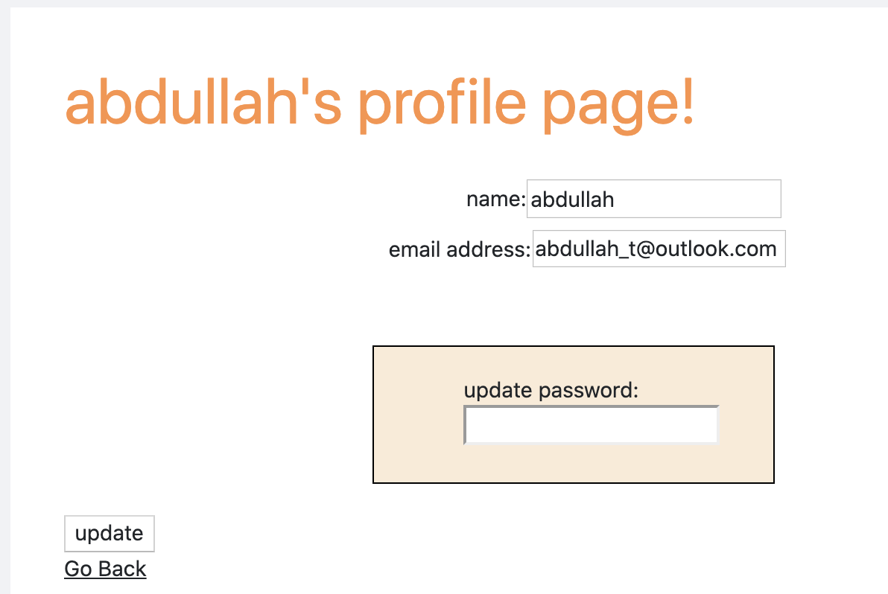
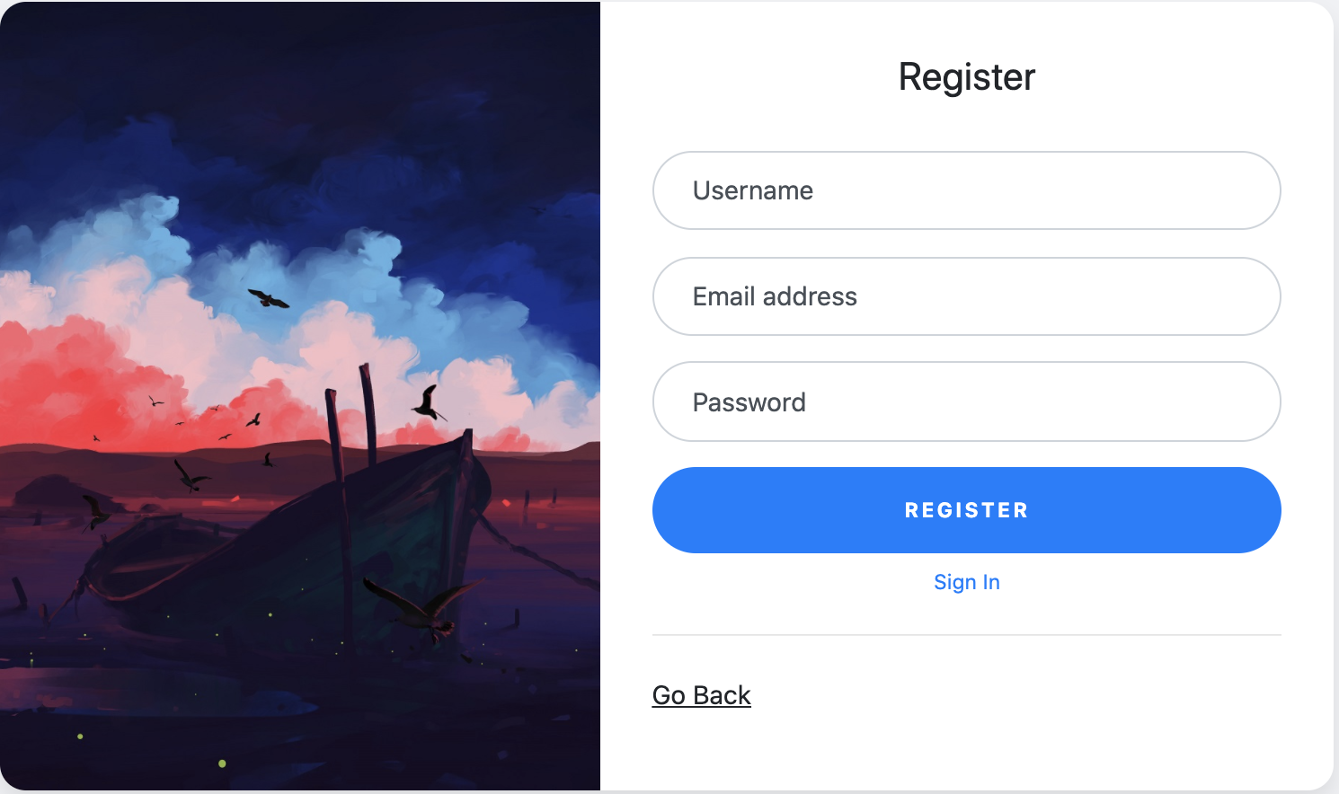
LOGIN/REGISTER AND PROFILE PAGE
Can change their name, email and password by entering the new data and clicking update
User enters credentials to login or can register instead.
Go back to the previous page
Enters a username, email and password of their choice and register an account.

Slide 13
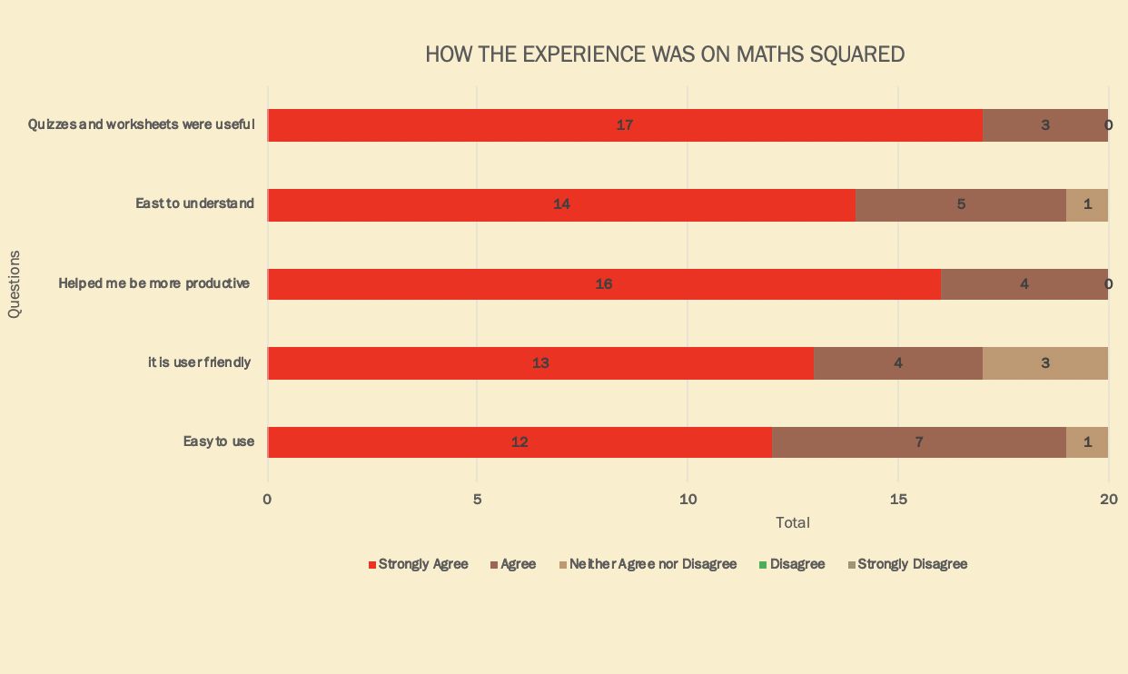
SURVEY AND RESULTS
Survey done after the testing phase (9-13th April)
5 questions with answers ranging from 1 (strongly disagree) to 5 (strongly agree)
20 people were asked ranging from age 10 to 22
Users experienced a satisfying session
Content easy to understand
Quizzes and worksheets boosted confidence and productivity
Ease of use navigating through the pages and website
User understood how the website functions

Slide 14
CONCLUSION
This project has successfully delivered a fully working product which focuses on students being able to learn maths content. It allows the user to select a course of their choice and begin to learn. A dashboard interface has been created for users who want to create an account which includes some extra benefits compared to those that decide not to make an account. These users can access all the content and quizzes as well as viewing their latest quiz results. At this moment, the website offers a total of eight different courses with twenty-eight topics.
The development stage of the project went well overall, although there were some technical issues which as a result lead to some delays. However, by following agile methodology, this allowed flexibility to prioritise certain tasks and requirements. There was also some implementation which involved a steep learning curve, however, once the difficulties were overcome, they were implemented and added to the website.
Finally, this project aimed to make sure users leave the website feeling satisfied with what they have learnt and ensure the users are attracted to the website which I feel was a success. The content provided is presented in a simple manner and is easily understandable by all ages. All the essential requirements were met in order to make the aims a success. Videos, quizzes and worksheets are accessible to the users making their learning experience better. The simple user interface makes this application user friendly and self explanatory on how to use it. Along side its simplicity its overall appearance is appealing to the eye and is easy to understand

Slide 15
REFLECTION
During this project, I had to overcome many unpredicted obstacles that was not predicted as well as improving some skills.
Technical skills was the most improved skills in my personal development. This project was one of the biggest and complex projects I have worked on. It involved me learning languages that I have never experienced such as HTML, CSS and JavaScript. I found JavaScript to be the most difficult for me. It took me a long time to understand how it worked, but after taking the time out to learn it, it gave me the confidence to learn other languages.
There was some problems when creating the project. With the website, I wanted to always achieve the best- looking website and spend a great amount of time in the design phase for small parts of the website. This is because I take pride in my work and so I wanted to create the engaging GUI which resulted in delaying other tasks. There were also points where the stress was too much for me which affected my performance and made me make rash mistakes.
Overall, I believe the experience I have gained from this project will influence my performance in the coming years starting from now and set me in the right direction in my post-graduate future. In fact, in a recent job interview, the employer was interested by the project. They were impressed with what I have created as well as the diverse skillset that was involved in making this project. Straight away, I believe this project was a success professionally and as a personal achievement.

